Slide 1
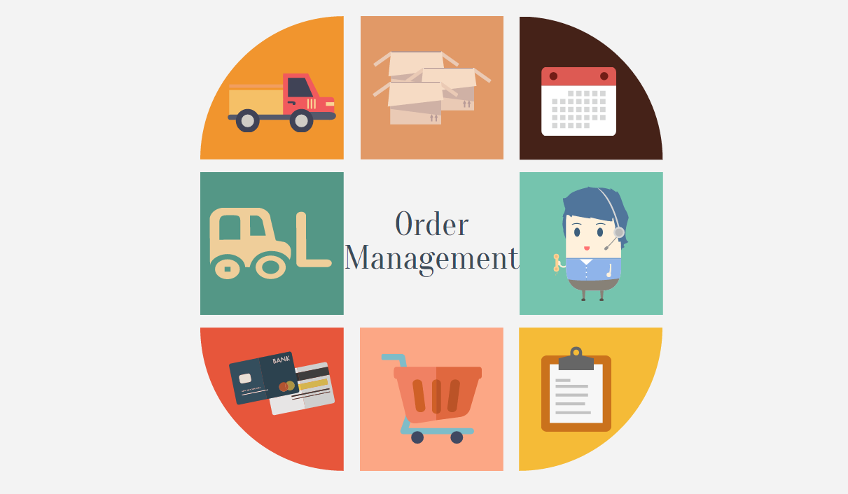
ORDER MANGMENT SYSTEM
Presented BY.
P. NIKHILA
MAHVEESH FATHIMA
SHRAVYA.K
SHIVANI.K
VYSHNAVI.M

Slide 2

Introduction
The Order Management System is a crucial component of any e-commerce website, facilitating the process of ordering products and managing customer orders. It serves as the backbone of the online shopping experience, ensuring smooth transactions and efficient order fulfillment.

Slide 3
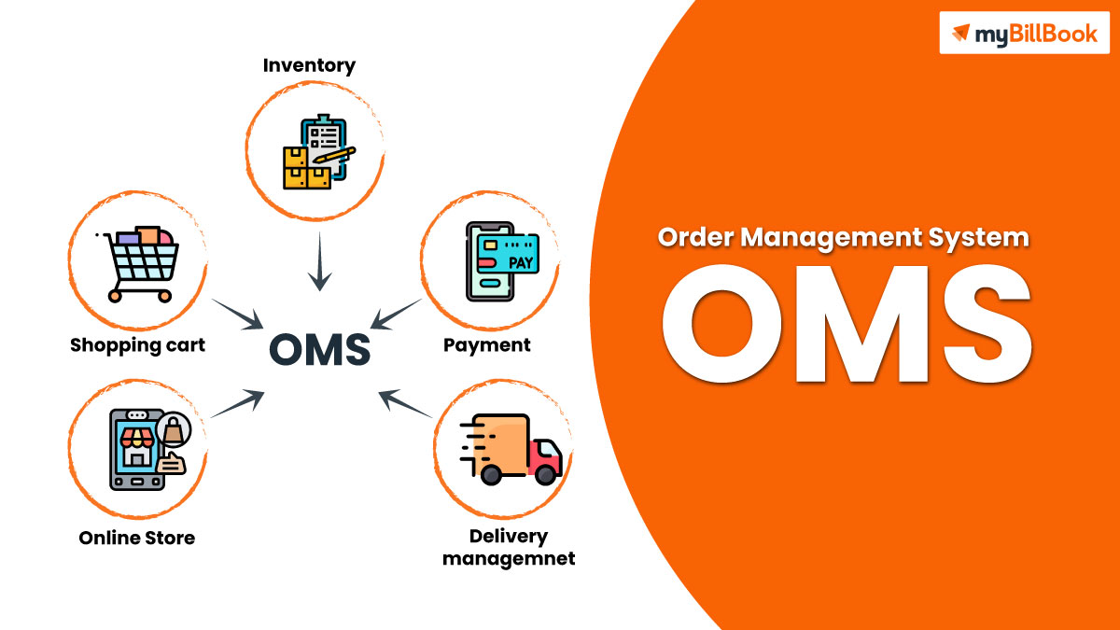
Problem Statement
The purpose of the Order Management System is to streamline the ordering process, from the moment a customer adds items to their cart to the final delivery of the products. It integrates various functionalities, such as inventory management, payment processing, and order tracking, to provide a seamless and convenient shopping experience for customers.

Slide 4
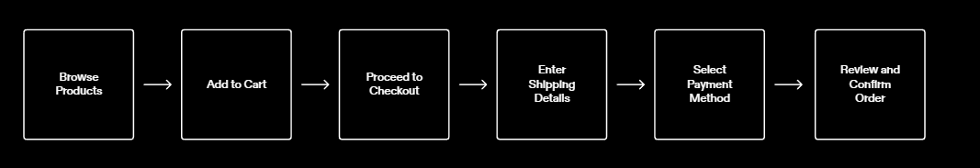
Flow

Slide 5
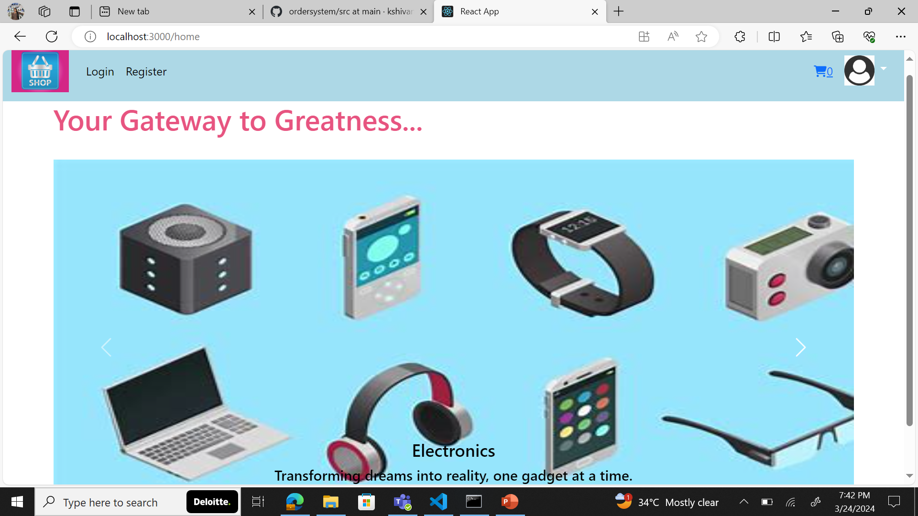
User Interface
The user interface of the Order Management System is designed to be intuitive and user-friendly, providing a seamless experience for users.
Design and Layout
The design of the user interface is clean and modern, with a focus on simplicity and clarity.
The layout is organized and easy to navigate, with clear labels and intuitive icons.
The color palette is chosen to be visually appealing and easy on the eyes.
The typography is carefully selected for readability and consistency.
The interface is responsive and can adapt to different screen sizes and devices.

Slide 6
Features of the Order Management System
User Registration and Authentication
Order Placemen or cart
Order Tracking
Inventory Management
Payment Processing
Customer Support and Helpdesk

Slide 7
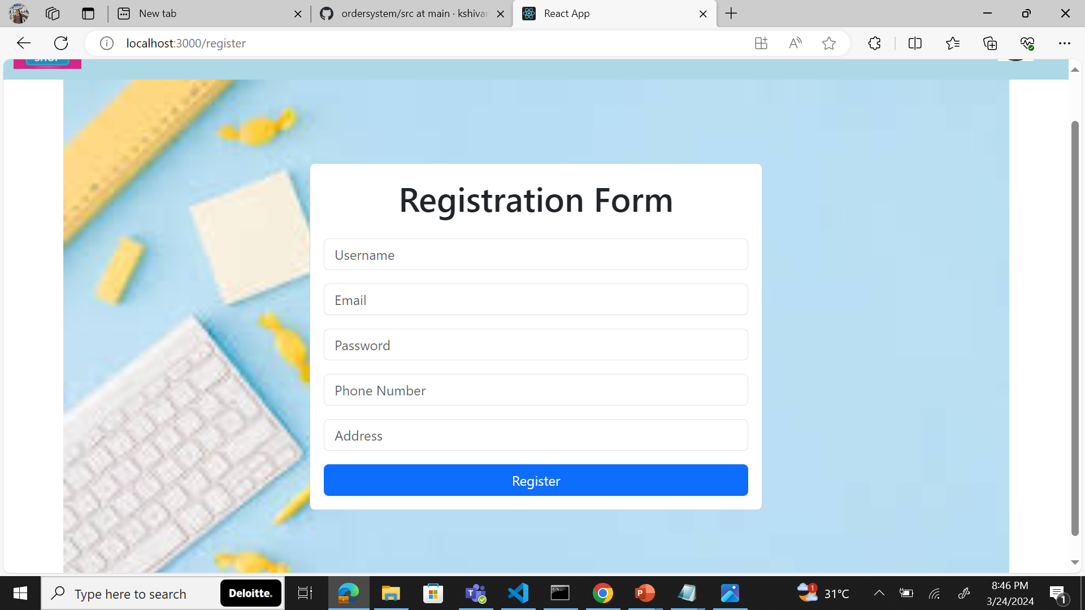
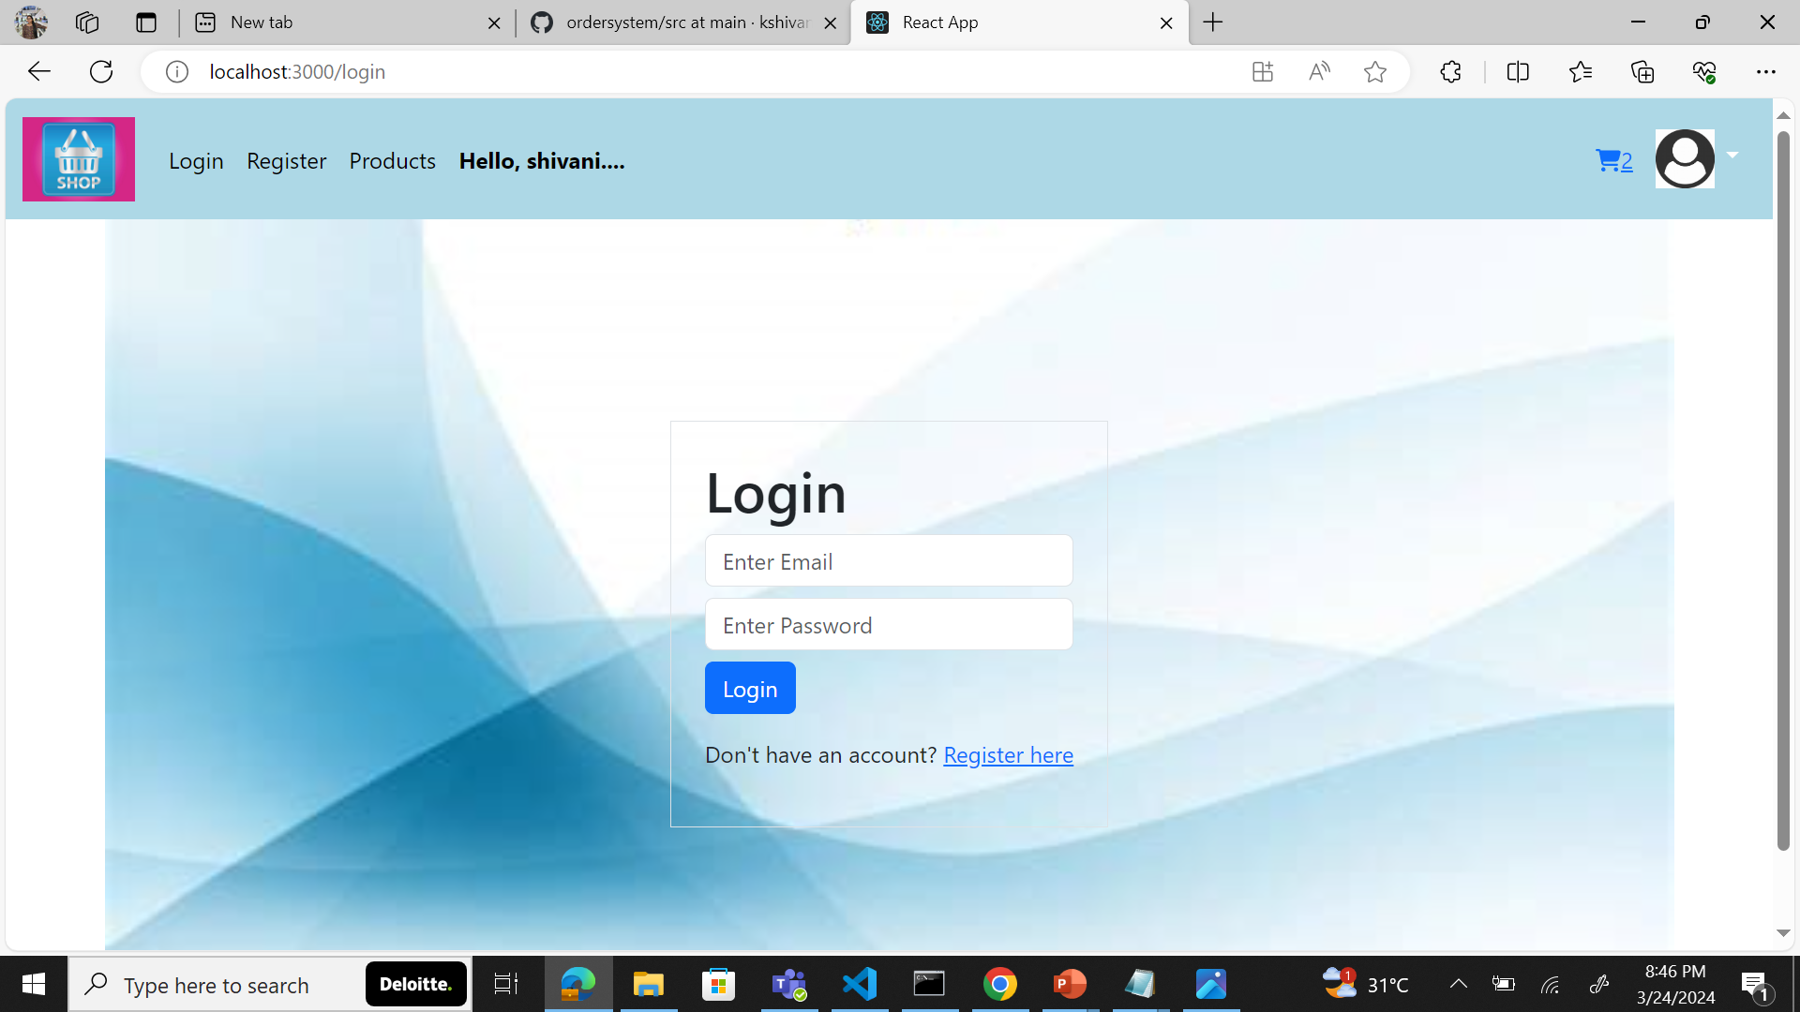
User Registration and Authentication
The forms authentication stores username and passwords in the database and requires users to register to site before they can log in

Slide 8
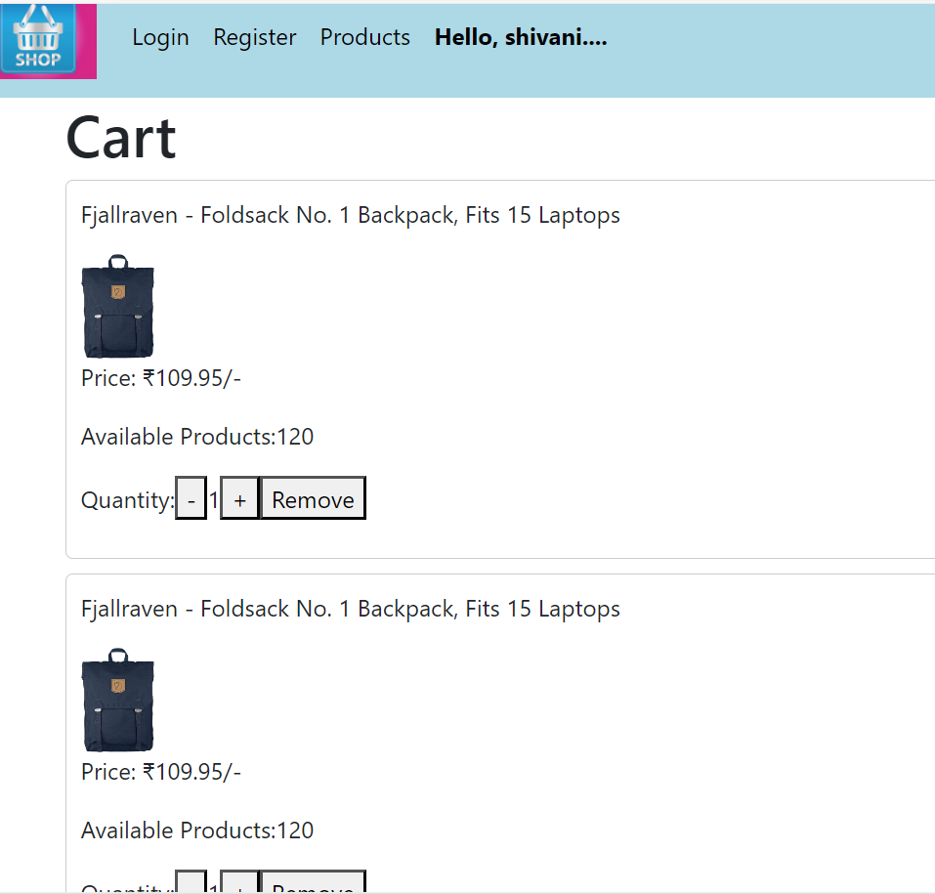
Cart
1.
Simple and efficient to use
2.
Areas for communication and connection to the order
3.
It stores the product details

Slide 9
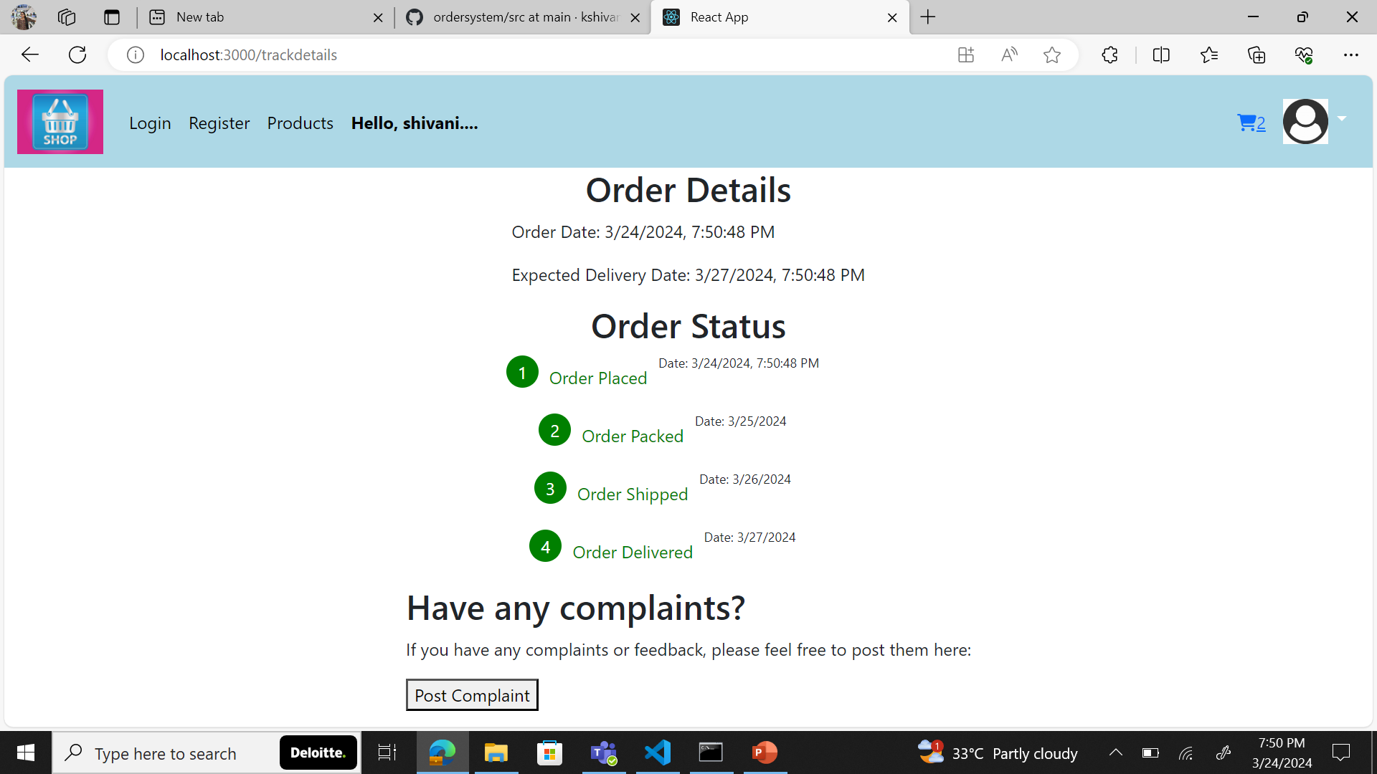
Tracking
The Order Management System allows customers to track their orders in real-time, providing them with updates on the status of their orders and estimated delivery dates
1. Click on "My orders"

Slide 10
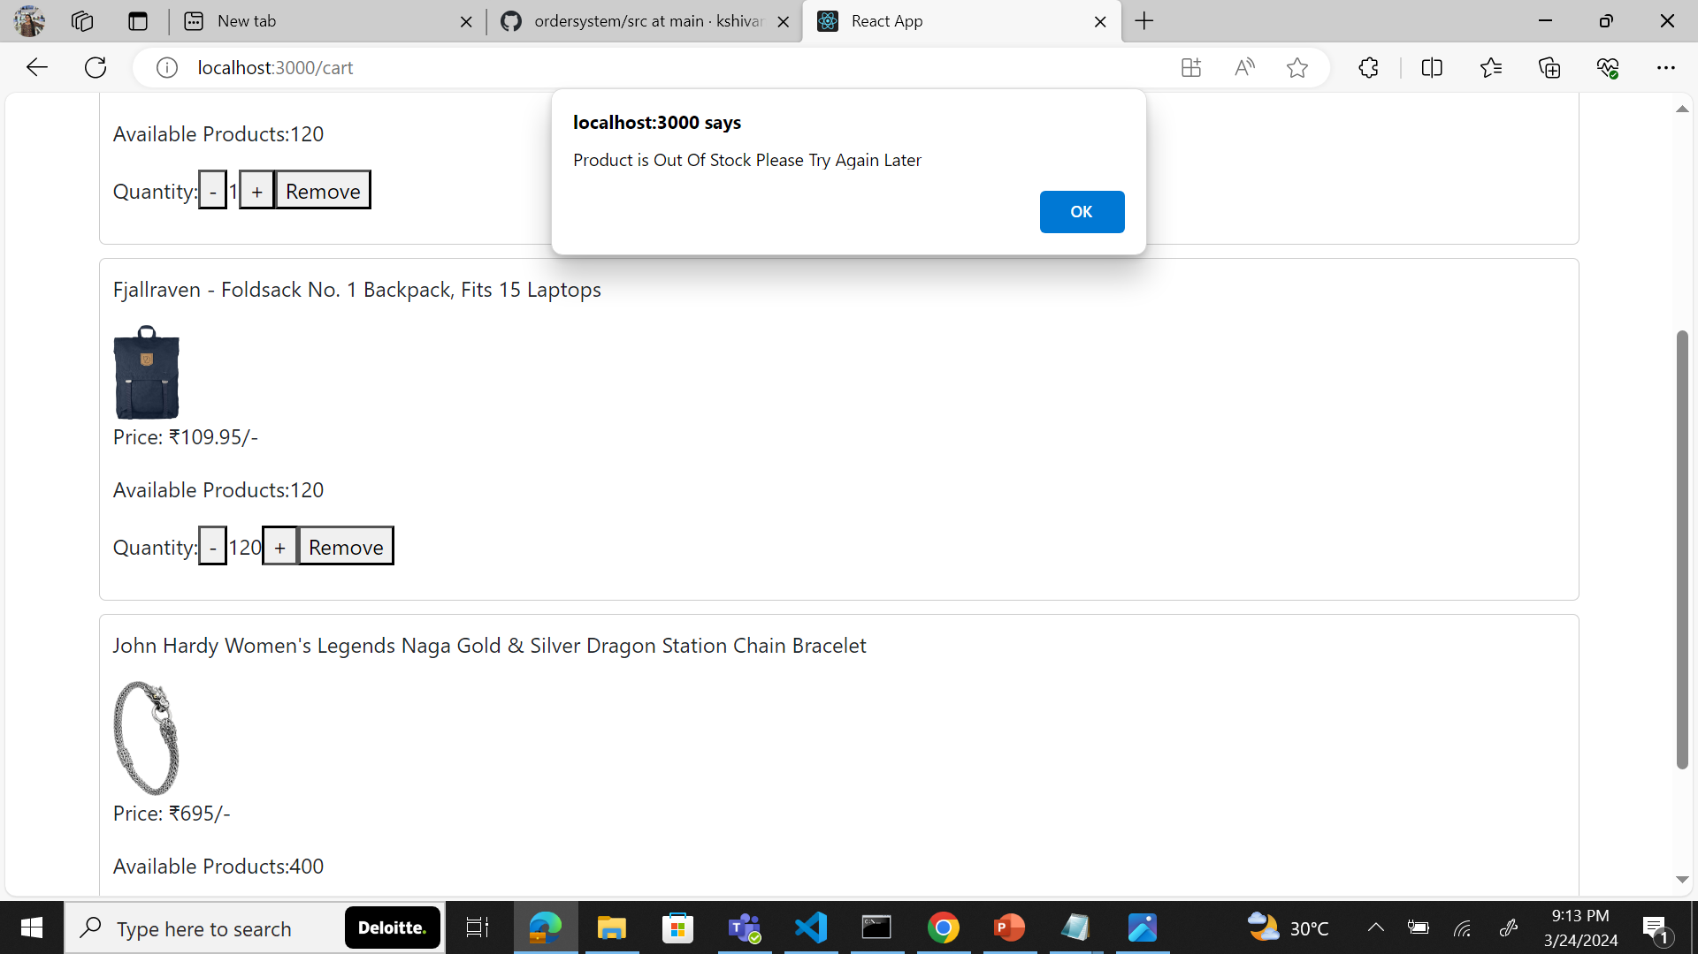
Inventory Management
The Order Management System helps businesses manage their inventory by providing real-time visibility into stock levels, allowing them to track and control inventory across multiple locations.

Slide 11
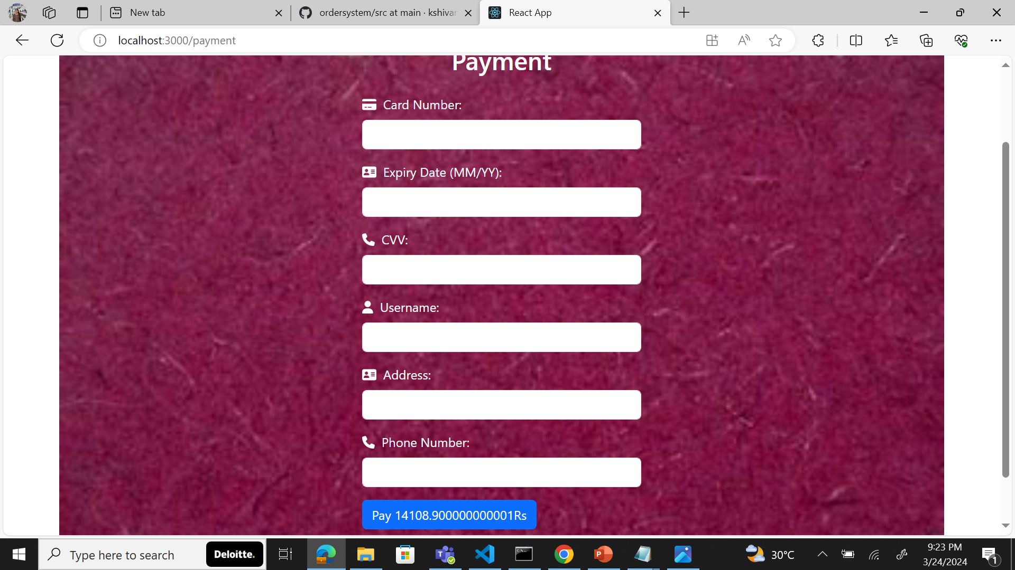
Payment Processing

Slide 12
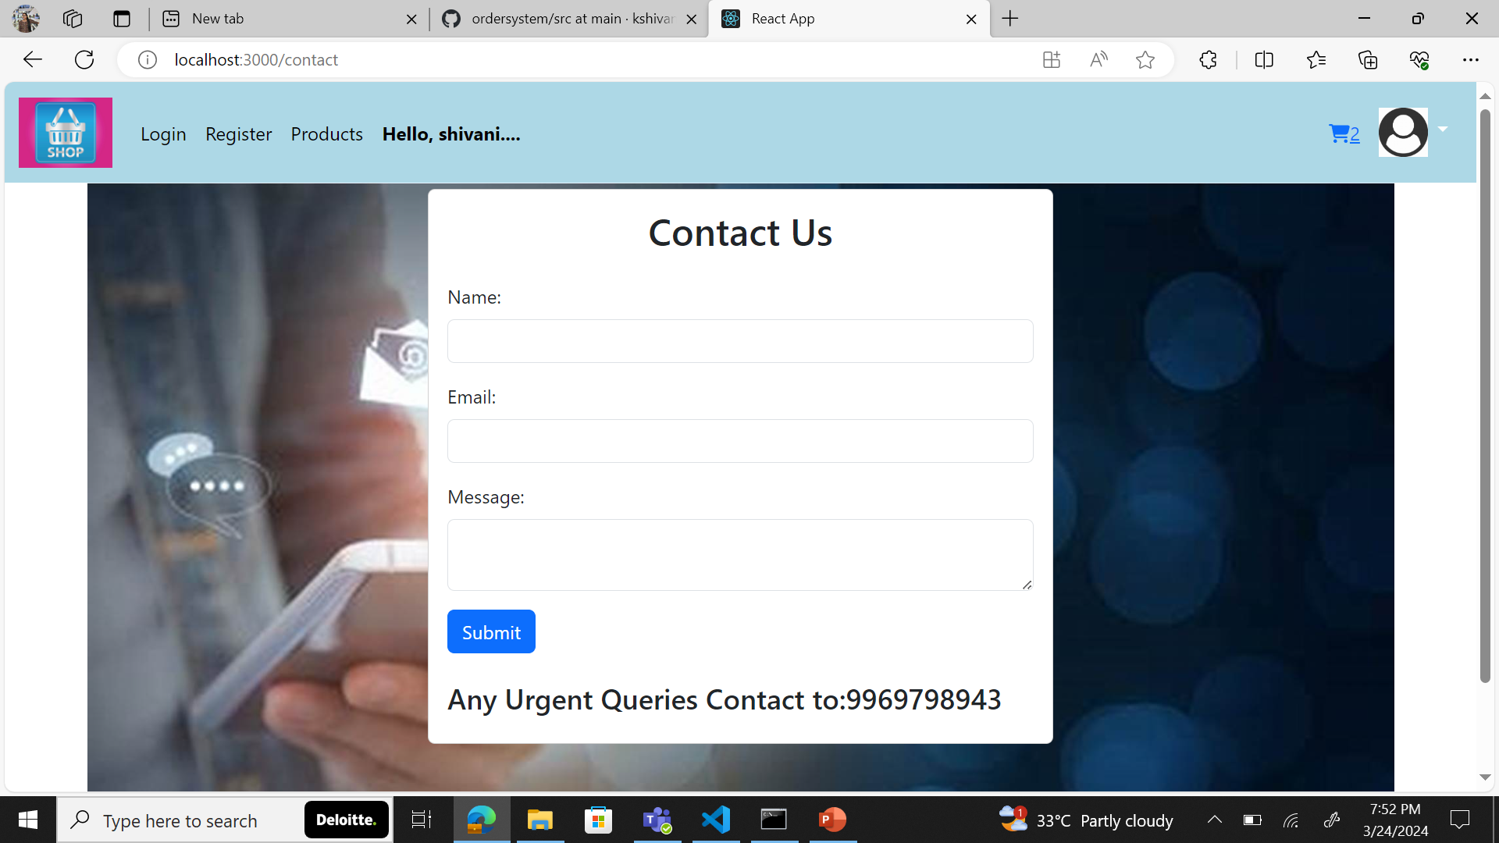
Customer Support and Helpdesk
A Contact Us page where we take reviews and we provide our services
Customer support can have a significant influence on satisfaction

Slide 13

Thank You

